Slide 1
Measures of Dispersion
Md. Ismail Hossain Riday

Slide 2
Dispersion
In previous chapter, we learned how to summarize a raw data set using a single value that indicates the center of the distribution.

Slide 3
Dispersion
In previous chapter, we learned how to summarize a raw data set using a single value that indicates the center of the distribution.
It gives only partial information of the data set.

Slide 4
Dispersion
For example, Record the examination results of two students
Student A: 50, 49, 51, 50
Student B: 100, 100, 0, 0

Slide 5
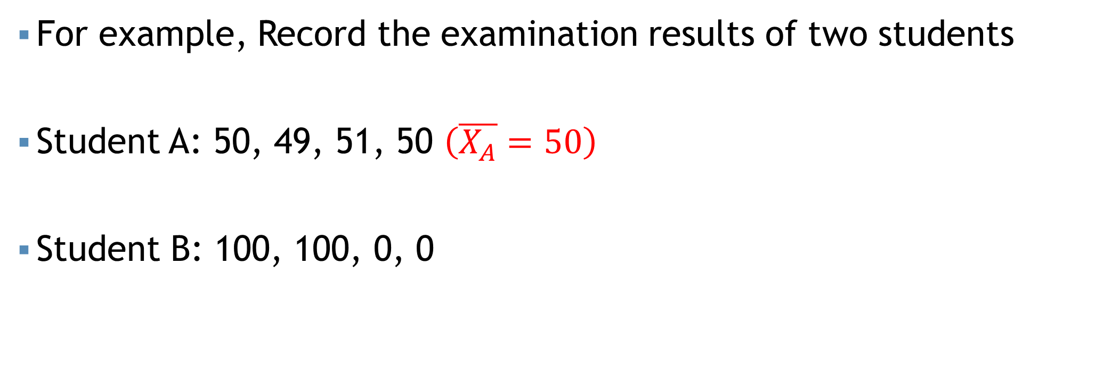
Dispersion
For example, Record the examination results of two students
Student A: 50, 49, 51, 50 $\left(\overline{X_{A}}=50\right)$
Student B: 100, 100, 0, 0

Slide 6
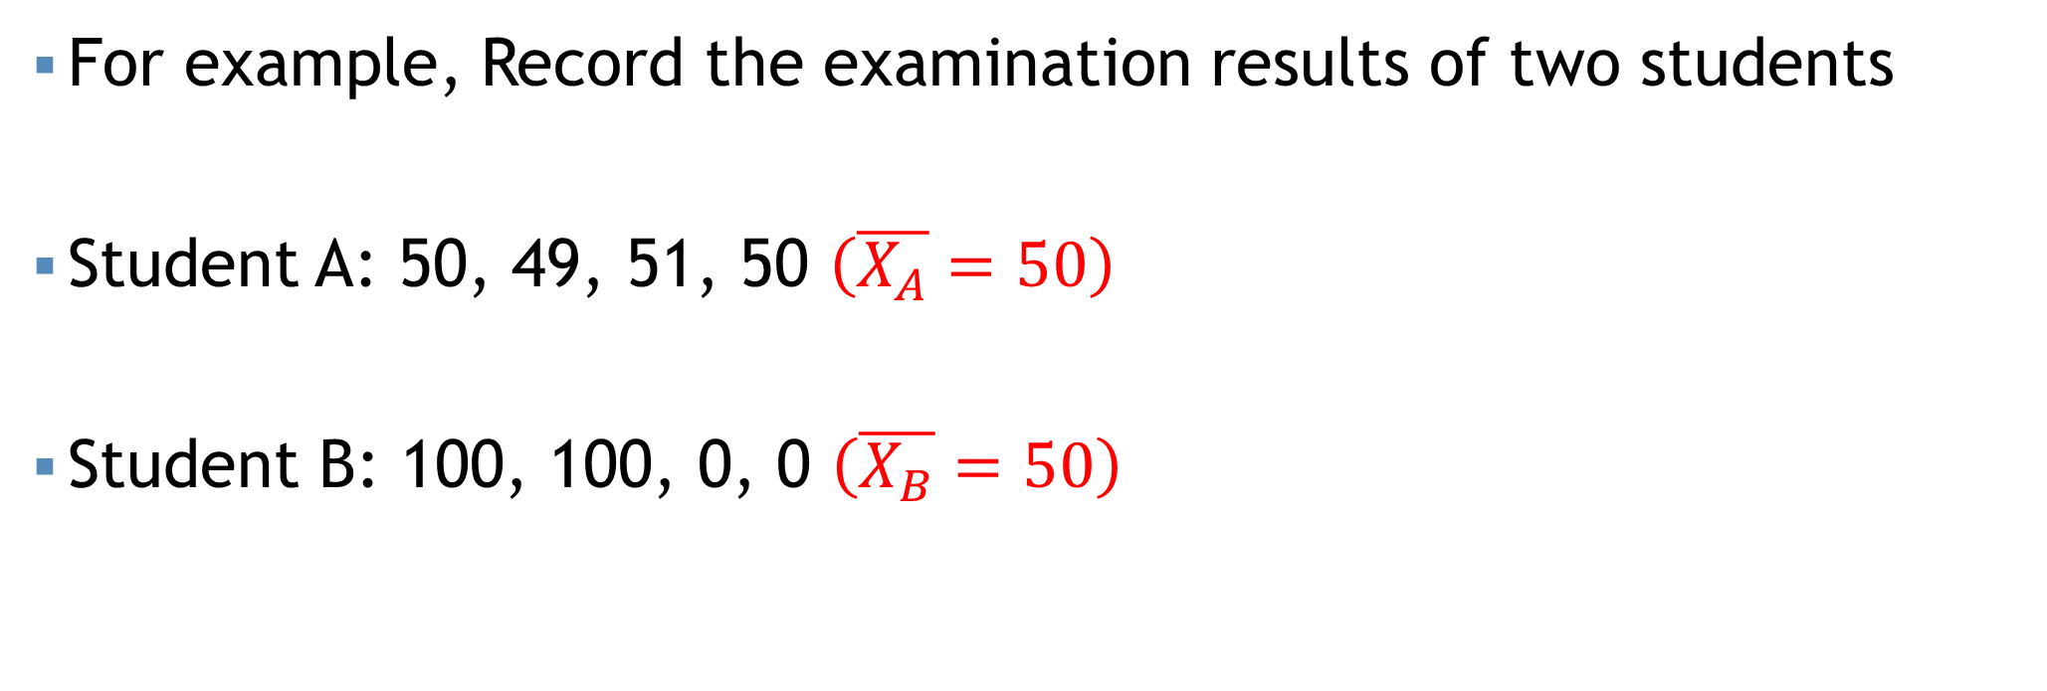
Dispersion
For example, Record the examination results of two students
Student A: 50, 49, 51, 50 $\left(\overline{X_{A}}=50\right)$
Student B: 100, 100, 0, 0 $\left(\overline{X_{B}}=50\right)$

Slide 7
Dispersion
For example, Record the examination results of two students
Student A: 50, 49, 51, 50 $\left(\overline{X_{A}}=50\right)$
Student B: 100, 100, 0, 0 $\left(\overline{X_{B}}=50\right)$
On average both students are equal in getting final exam score

Slide 8
Dispersion
For example, Record the examination results of two students
Student A: 50, 49, 51, 50 $\left(\overline{X_{A}}=50\right)$
Student B: 100, 100, 0, 0 $\left(\overline{X_{B}}=50\right)$
On average both students are equal in getting final exam score
So it is also important to describe “How much the observation vary from one to another
Dispersion/ Variation

Slide 9
Measures of Dispersion
Dispersion may describe how much the observation vary from one to another.

Slide 10
Measures of Dispersion
Dispersion may describe how much the observation vary from one to another.
Descriptive measures that indicate the amount of variation in a data set are called measures of dispersion.

Slide 11
Why do we need?
To determine the reliability of an average
To compare the variability of two or more data sets.

Slide 12
Types of Measures of Dispersion
Measures of Dispersion

Slide 13
Types of Measures of Dispersion
Measures of Dispersion
Absolute Measures

Slide 14
Types of Measures of Dispersion
Measures of Dispersion
Absolute Measures
Relative Measures

Slide 15
Absolute measures
Only measure the inherent variation of a data set

Slide 16
Absolute measures
Only measure the inherent variation of a data set

Slide 17
Absolute measures
Only measure the inherent variation of a data set
Range

Slide 18
Absolute measures
Only measure the inherent variation of a data set
Range
Mean Deviation

Slide 19
Absolute measures
Only measure the inherent variation of a data set
Range
Mean Deviation
Variance

Slide 20
Absolute measures
Only measure the inherent variation of a data set
Range
Mean Deviation
Variance
Quartile Deviation

Slide 21
Absolute measures
Only measure the inherent variation of a data set
Range
Mean Deviation
Variance
Quartile Deviation

Slide 22

Range
$Range=Highest value−Lowest value$

Slide 23
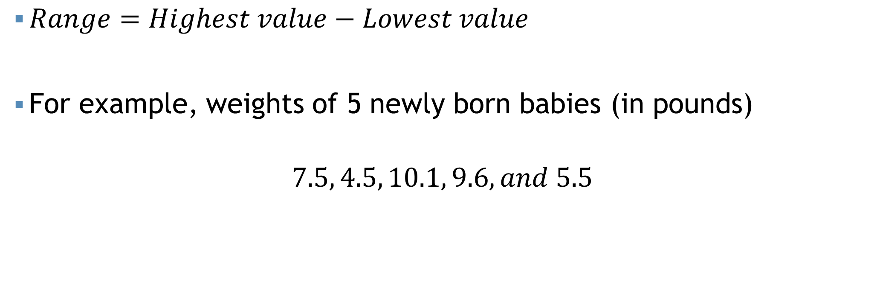
Range
$Range=Highest value−Lowest value$
For example, weights of 5 newly born babies (in pounds)
$$7.5, 4.5, 10.1, 9.6, and 5.5$$

Slide 24
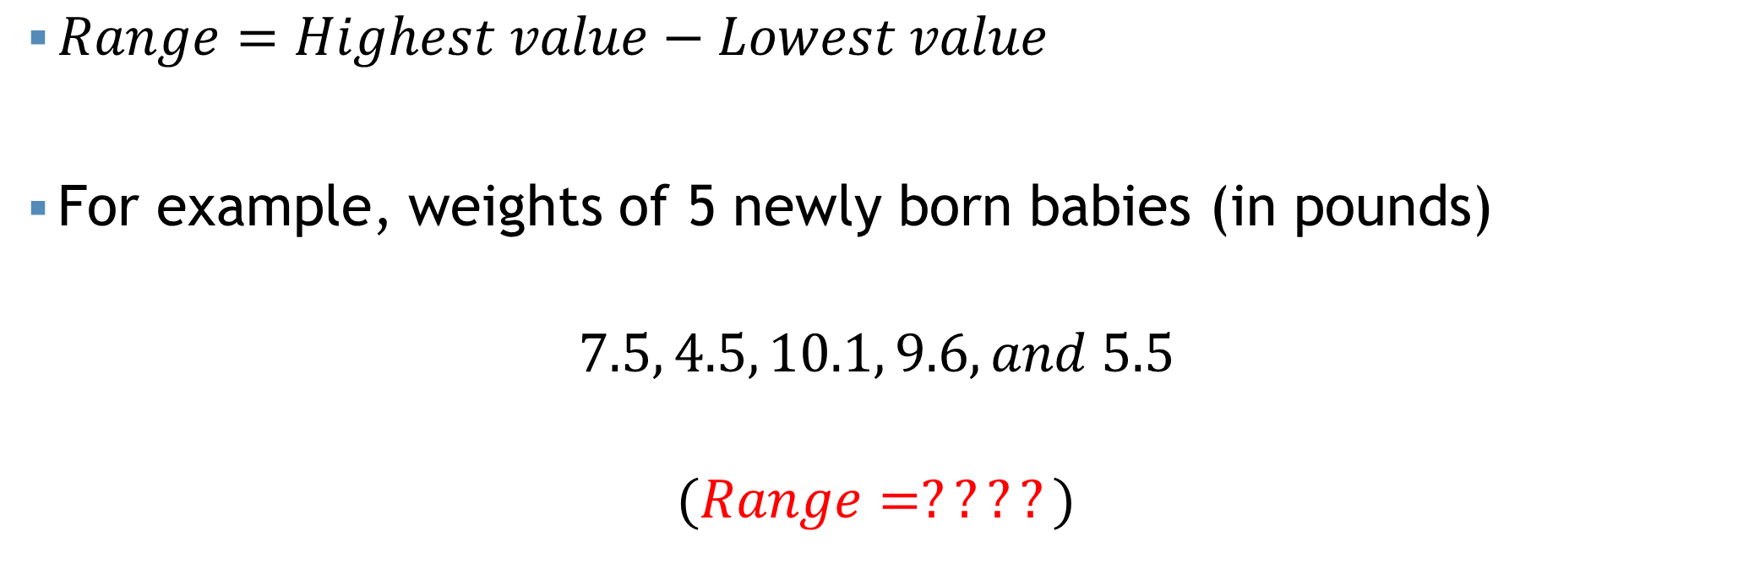
Range
$Range=Highest value−Lowest value$
For example, weights of 5 newly born babies (in pounds)
$$7.5, 4.5, 10.1, 9.6, and 5.5$$
$$(Range=????)$$

Slide 25
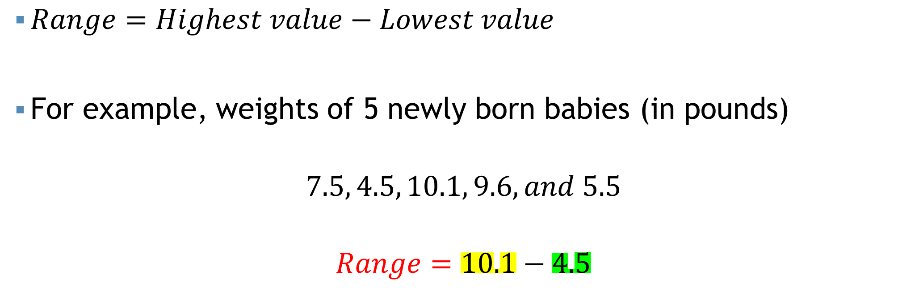
Range
$Range=Highest value−Lowest value$
For example, weights of 5 newly born babies (in pounds)
$$7.5, 4.5, 10.1, 9.6, and 5.5$$
$$Range=10.1−4.5$$

Slide 26
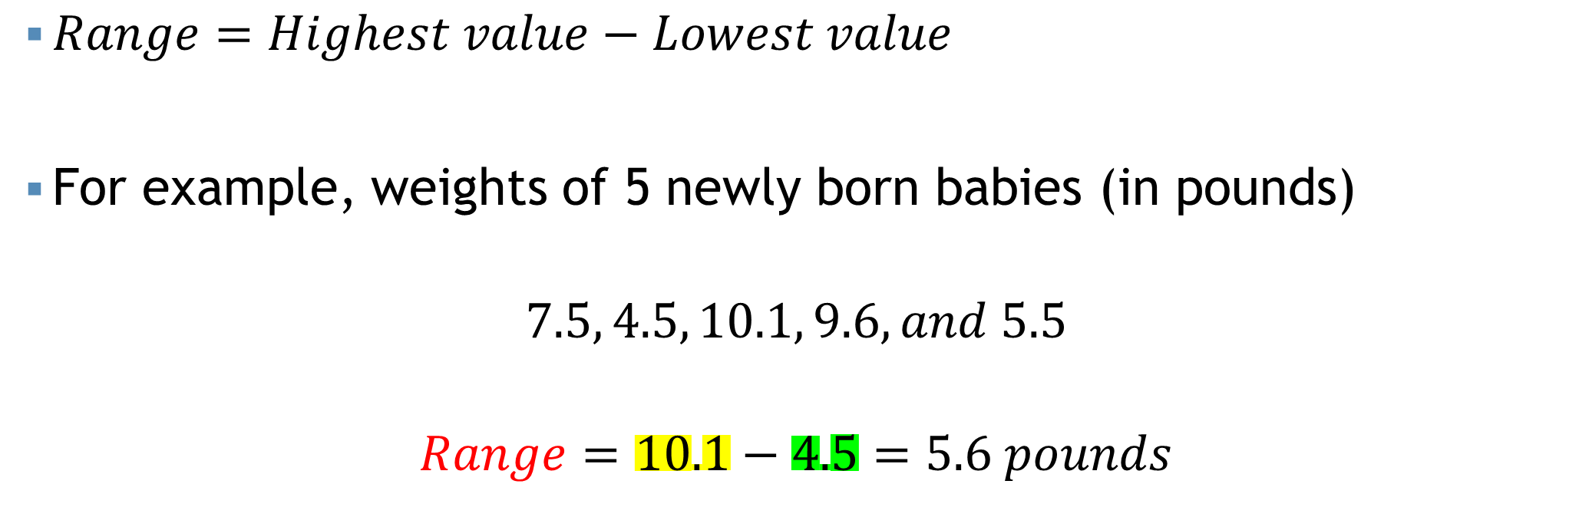
Range
$Range=Highest value−Lowest value$
For example, weights of 5 newly born babies (in pounds)
$$7.5, 4.5, 10.1, 9.6, and 5.5$$
$$Range=10.1−4.5=5.6 pounds$$

Slide 27

Mean Deviation
Let $x_{1},x_{2},…,x_{n}$ be $n$ observations, where $\overline{x}$ is average/ or mean

Slide 28

Mean Deviation
Let $x_{1},x_{2},…,x_{n}$ be $n$ observations, where $\overline{x}$ is average/ or mean
$MD=\frac{\sum{|x_{i}−\overline{x}|}}{n}$ [for ungrouped data]

Slide 29
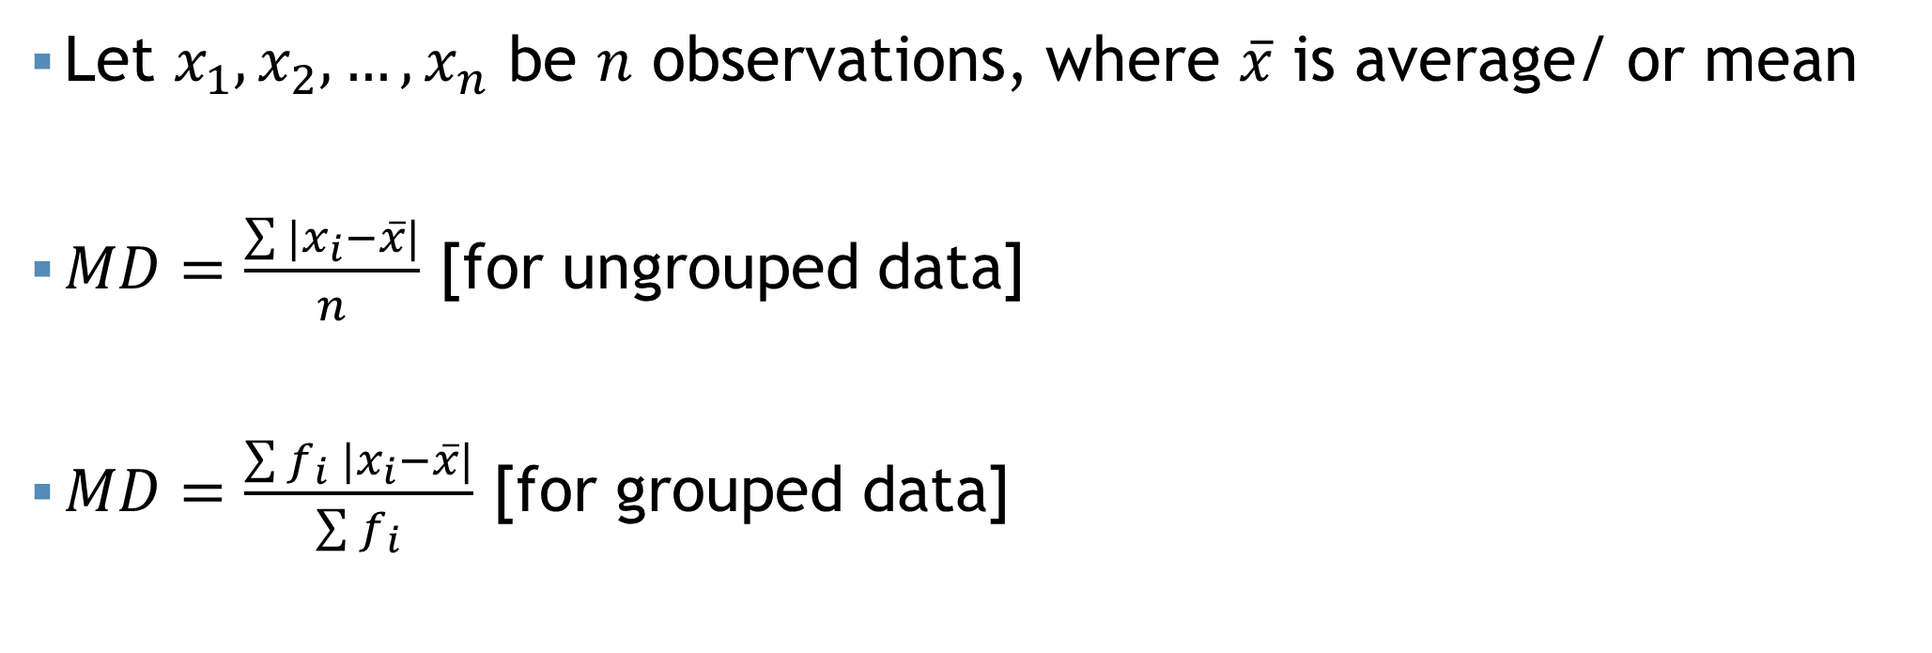
Mean Deviation
Let $x_{1},x_{2},…,x_{n}$ be $n$ observations, where $\overline{x}$ is average/ or mean
$MD=\frac{\sum{|x_{i}−\overline{x}|}}{n}$ [for ungrouped data]
$MD=\frac{\sum{f_{i} |x_{i}−\overline{x}|}}{\sum{f_{i}}}$ [for grouped data]

Slide 30

Mean Deviation
For example, $x=1,2,4,5$.

Slide 31
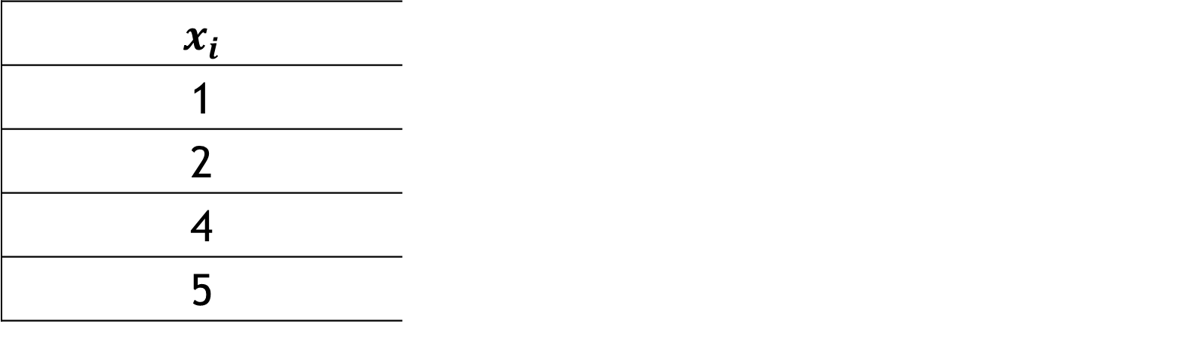

Mean Deviation
For example, $x=1,2,4,5$. Calculate the mean deviation.
$$x_{i}$$ | $$\overline{x}$$ | $$|x_{i}−\overline{x}|$$
1 | $$\frac{\sum{x_{i}}}{n}=3$$ | 2
2 |  | 1
4 |  | 1
5 |  | 2

Slide 32
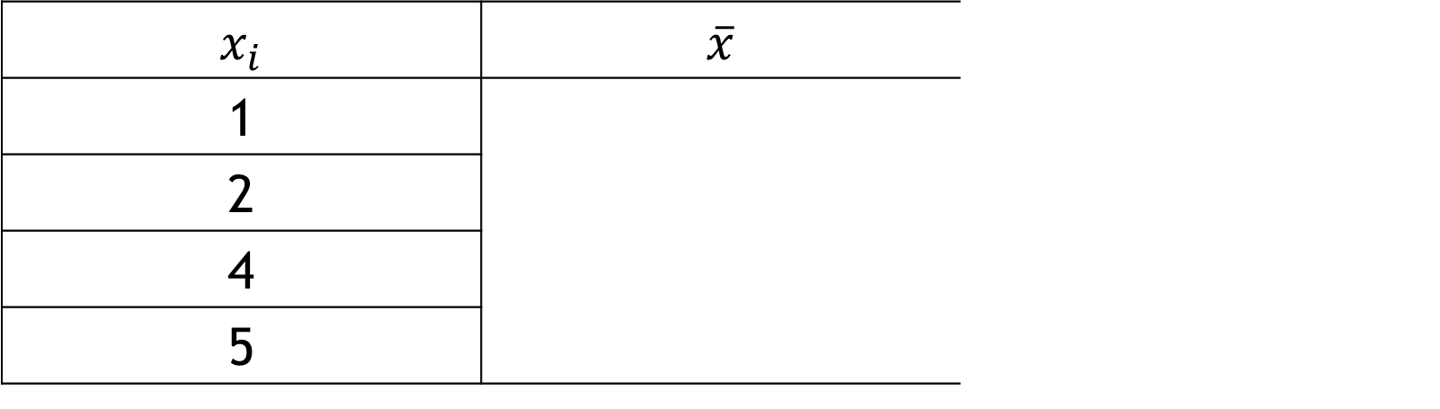
Mean Deviation
For example, $x=1,2,4,5$. Calculate the mean deviation.
$$x_{i}$$ | $$\overline{x}$$ | $$|x_{i}−\overline{x}|$$
1 |  | 2
2 |  | 1
4 |  | 1
5 |  | 2

Slide 33
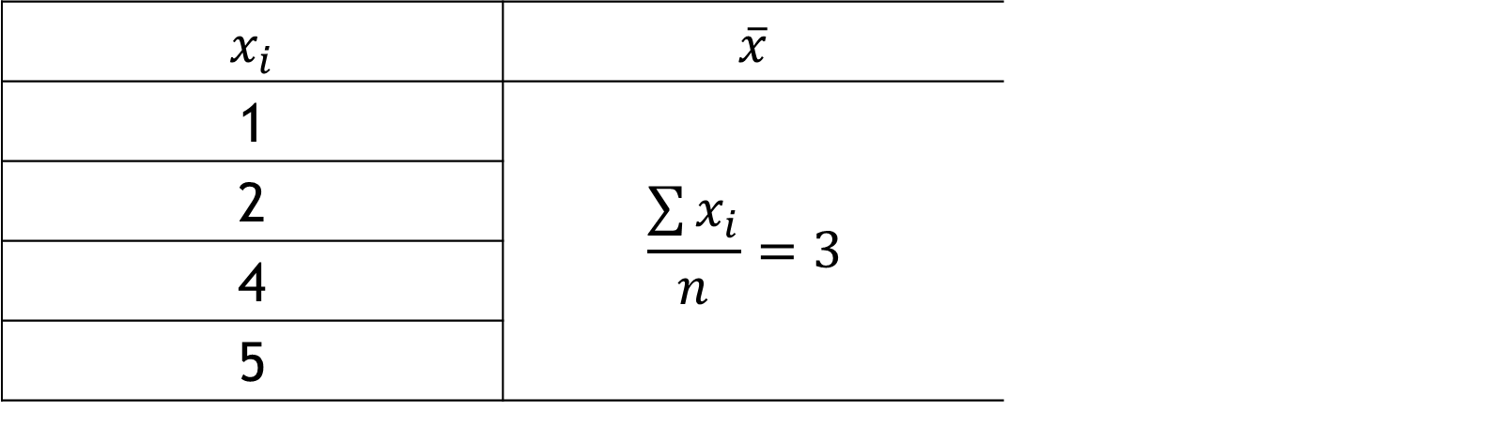
Mean Deviation
For example, $x=1,2,4,5$. Calculate the mean deviation.
$$x_{i}$$ | $$\overline{x}$$ | $$|x_{i}−\overline{x}|$$
1 | $$\frac{\sum{x_{i}}}{n}=3$$ | 2
2 |  | 1
4 |  | 1
5 |  | 2

Slide 34
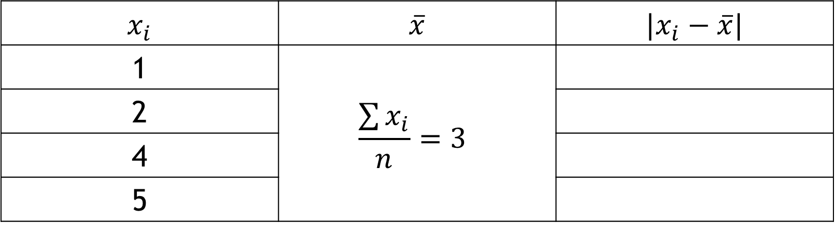
Mean Deviation
For example, $x=1,2,4,5$. Calculate the mean deviation.
$$x_{i}$$ | $$\overline{x}$$ | $$|x_{i}−\overline{x}|$$
1 | $$\frac{\sum{x_{i}}}{n}=3$$
2
4
5

Slide 35
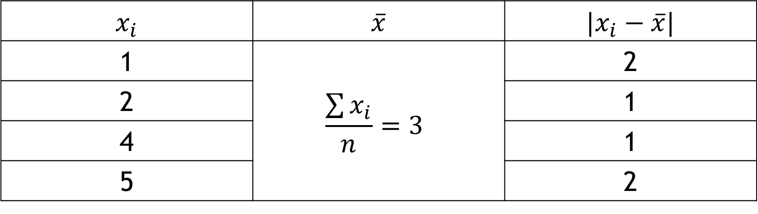
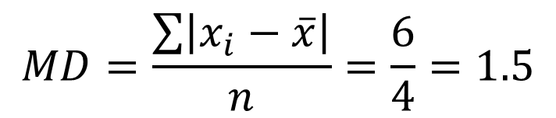
Mean Deviation
For example, $x=1,2,4,5$. Calculate the mean deviation.
$$x_{i}$$ | $$\overline{x}$$ | $$|x_{i}−\overline{x}|$$
1 | $$\frac{\sum{x_{i}}}{n}=3$$ | 2
2 |  | 1
4 |  | 1
5 |  | 2
$$MD=\frac{\sum{\left|x_{i}−\overline{x}\right|}}{n}=\frac{6}{4}=1.5$$

Slide 36

Variance
Let $x_{1},x_{2},…,x_{n}$ be $n$ observations

Slide 37
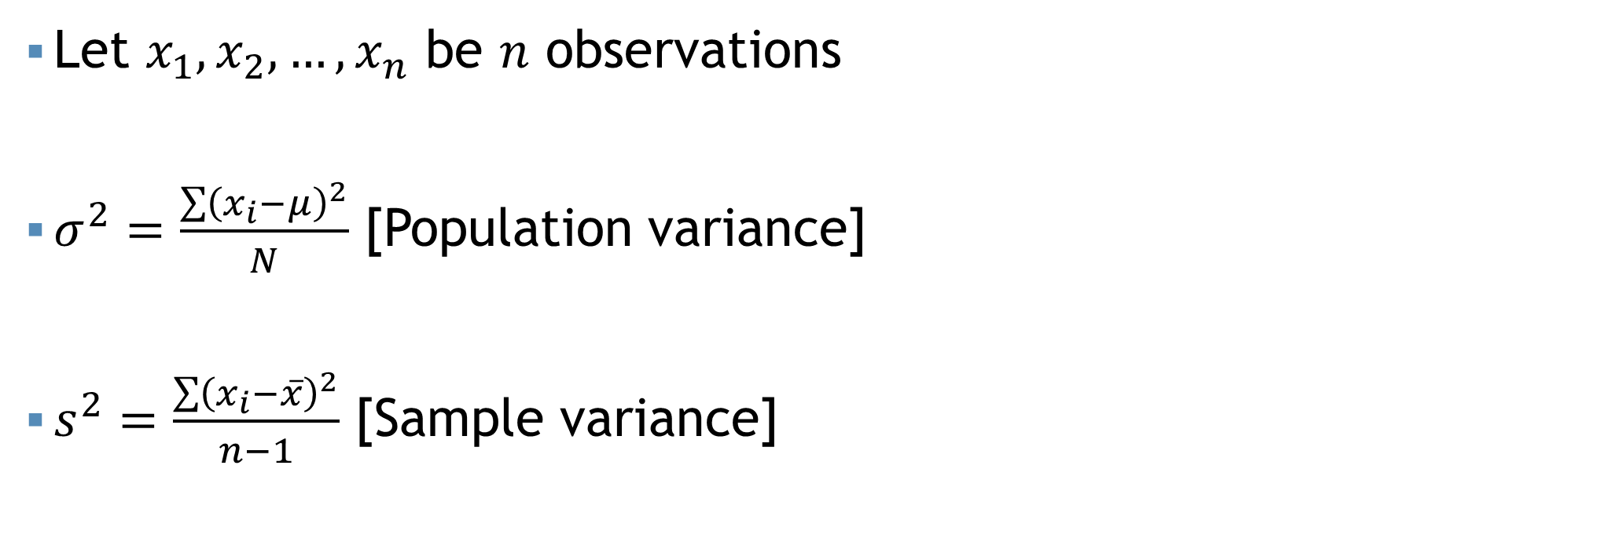
Variance
Let $x_{1},x_{2},…,x_{n}$ be $n$ observations
$σ^{2}=\frac{\sum{{\left(x_{i}−μ\right)}^{2}}}{N}$ [Population variance]
$s^{2}=\frac{\sum{{\left(x_{i}−\overline{x}\right)}^{2}}}{n−1}$ [Sample variance]

Slide 38
Standard Deviation
Square root of variance

Slide 39
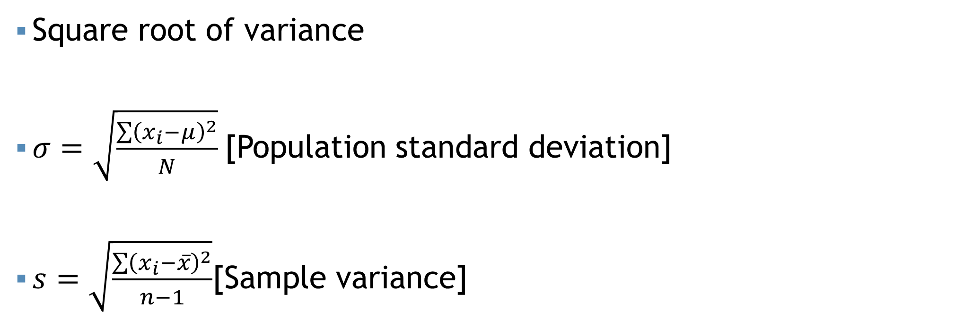
Standard Deviation
Square root of variance
$σ=\sqrt{\frac{\sum{{\left(x_{i}−μ\right)}^{2}}}{N}}$[Population standard deviation]
$s=\sqrt{\frac{\sum{{\left(x_{i}−\overline{x}\right)}^{2}}}{n−1}}$[Sample variance]

Slide 40
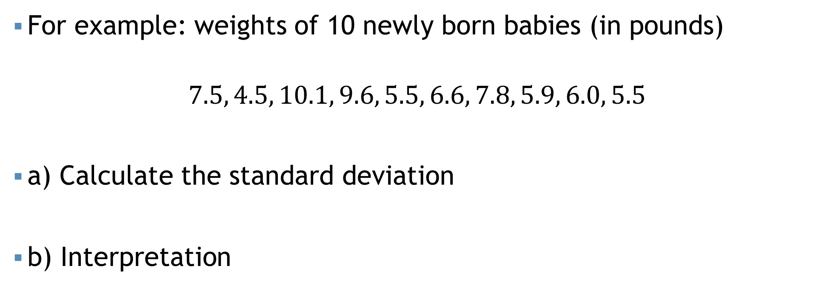
Standard Deviation
For example: weights of 10 newly born babies (in pounds)
$$7.5, 4.5, 10.1, 9.6, 5.5, 6.6, 7.8, 5.9, 6.0, 5.5$$
a) Calculate the standard deviation
b) Interpretation

Slide 41
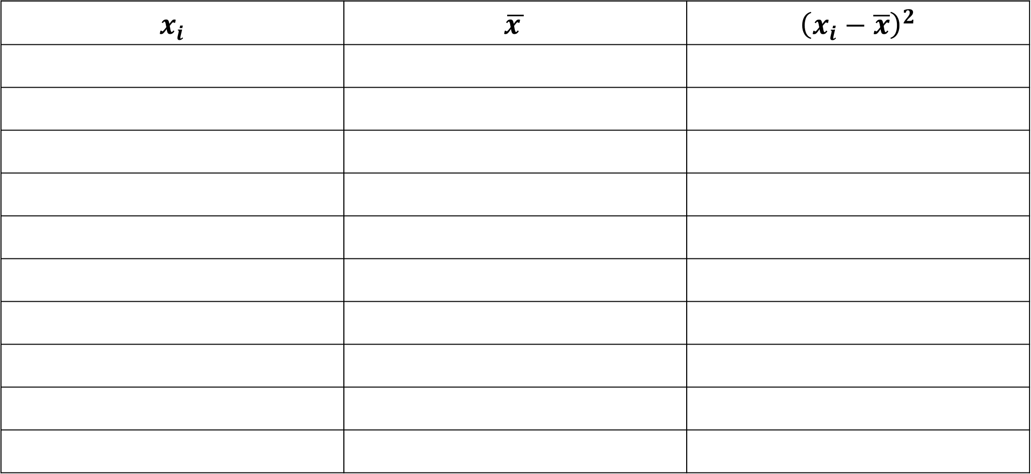
Standard Deviation
$$x_{i}$$ | $$\overline{x }$$ | $${\left(x_{i}−\overline{x}\right)}^{2}$$

Slide 42
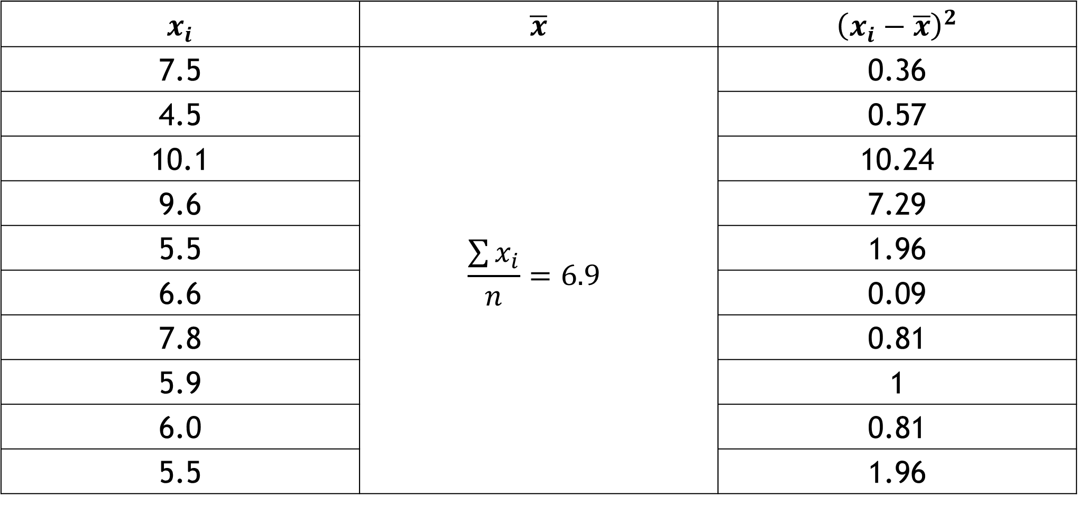
Standard Deviation
$$x_{i}$$ | $$\overline{x}$$ | $${\left(x_{i}−\overline{x}\right)}^{2}$$
7.5 | $$\frac{\sum{x_{i}}}{n}=6.9$$ | 0.36
4.5 |  | 0.57
10.1 |  | 10.24
9.6 |  | 7.29
5.5 |  | 1.96
6.6 |  | 0.09
7.8 |  | 0.81
5.9 |  | 1
6.0 |  | 0.81
5.5 |  | 1.96

Slide 43
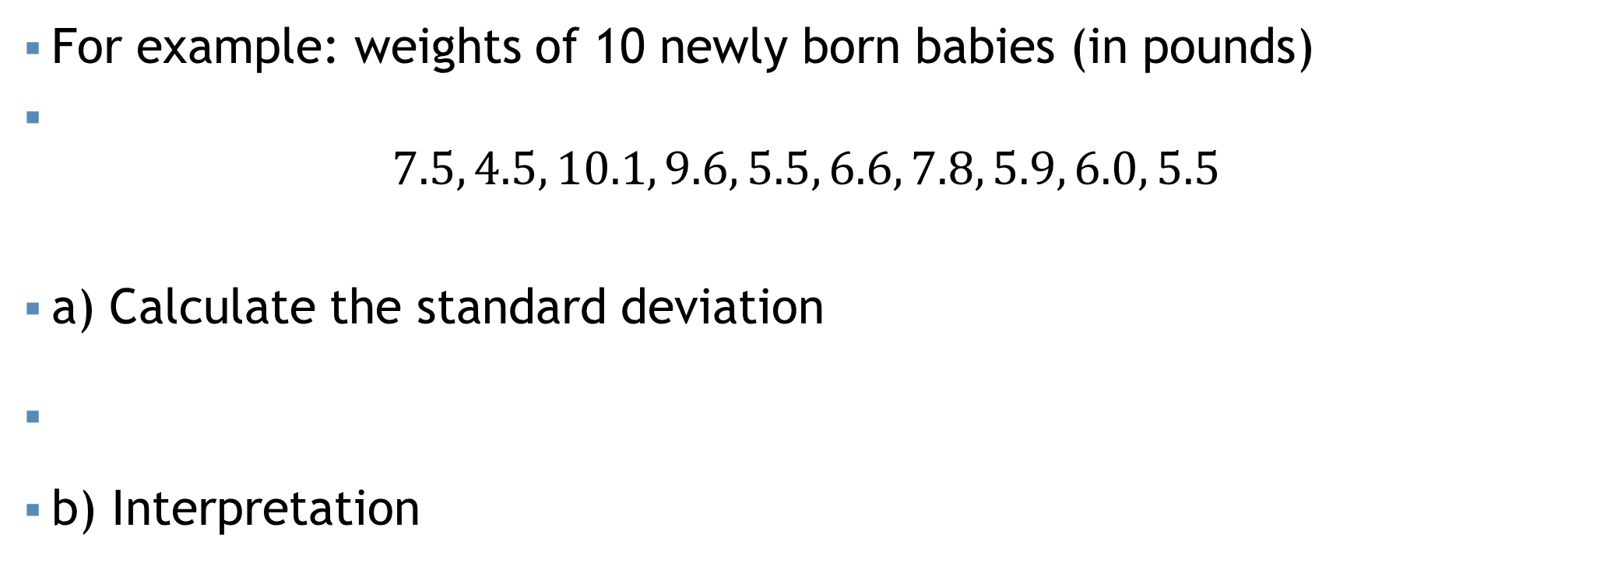
Standard Deviation
For example: weights of 10 newly born babies (in pounds)
$$7.5, 4.5, 10.1, 9.6, 5.5, 6.6, 7.8, 5.9, 6.0, 5.5$$
a) Calculate the standard deviation
$s=\sqrt{\frac{\sum{{\left(x_{i}−\overline{x}\right)}^{2}}}{n−1}}=\sqrt{\frac{30.28}{10−1}}=\sqrt{3.36}=1.83 pounds$
b) Interpretation

Slide 44
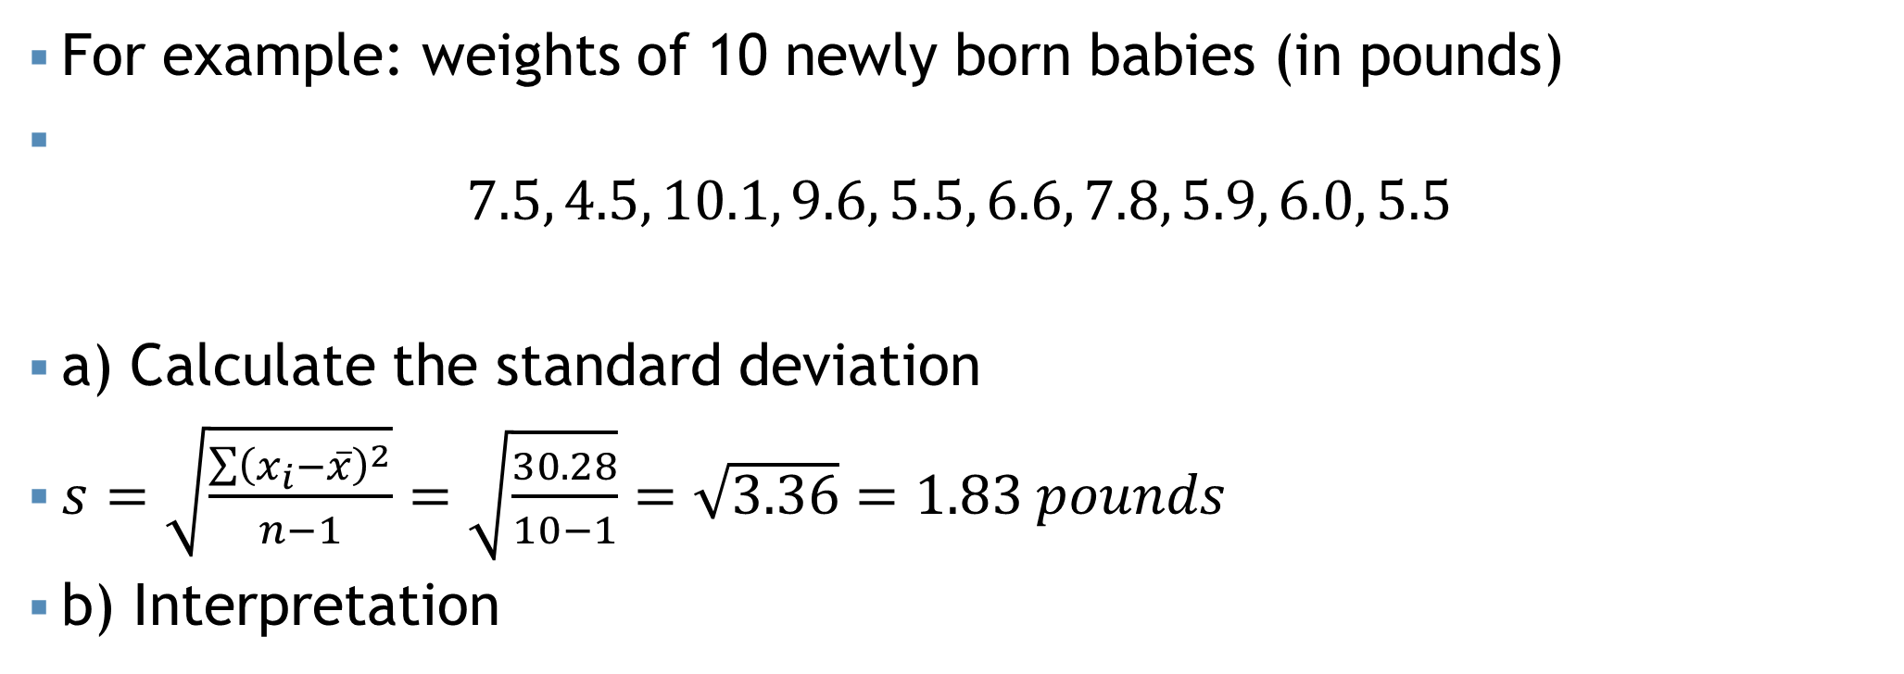
Standard Deviation
For example: weights of 10 newly born babies (in pounds)
$$7.5, 4.5, 10.1, 9.6, 5.5, 6.6, 7.8, 5.9, 6.0, 5.5$$
a) Calculate the standard deviation
$s=\sqrt{\frac{\sum{{\left(x_{i}−\overline{x}\right)}^{2}}}{n−1}}=\sqrt{\frac{30.28}{10−1}}=\sqrt{3.36}=1.83 pounds$
b) Interpretation
The average variation of the weights of the newly born babies from the mean weights is 1.83 pounds.

Slide 45
Relative measures
To compare the variation of two or more data sets having different or same units

Slide 46
Relative measures
To compare the variation of two or more data sets having different or same units
Coefficient of Range
Coefficient of MD
Coefficient of variance
Coefficient of QD

Slide 47
Relative measures
To compare the variation of two or more data sets having different or same units
Coefficient of Range
Coefficient of MD
Coefficient of variance
Coefficient of QD

Slide 48
Coefficient of variance (CV)
It is a ratio

Slide 49
Coefficient of variance (CV)
It is a ratio
Between standard deviation (SD) and mean

Slide 50
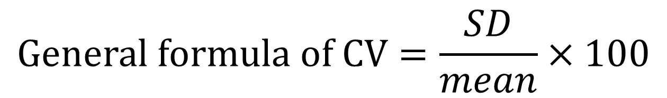
Coefficient of variance (CV)
It is a ratio
Between standard deviation (SD) and mean
Expressed as percent
$$General formula of CV=\frac{SD}{mean}×100$$

Slide 51
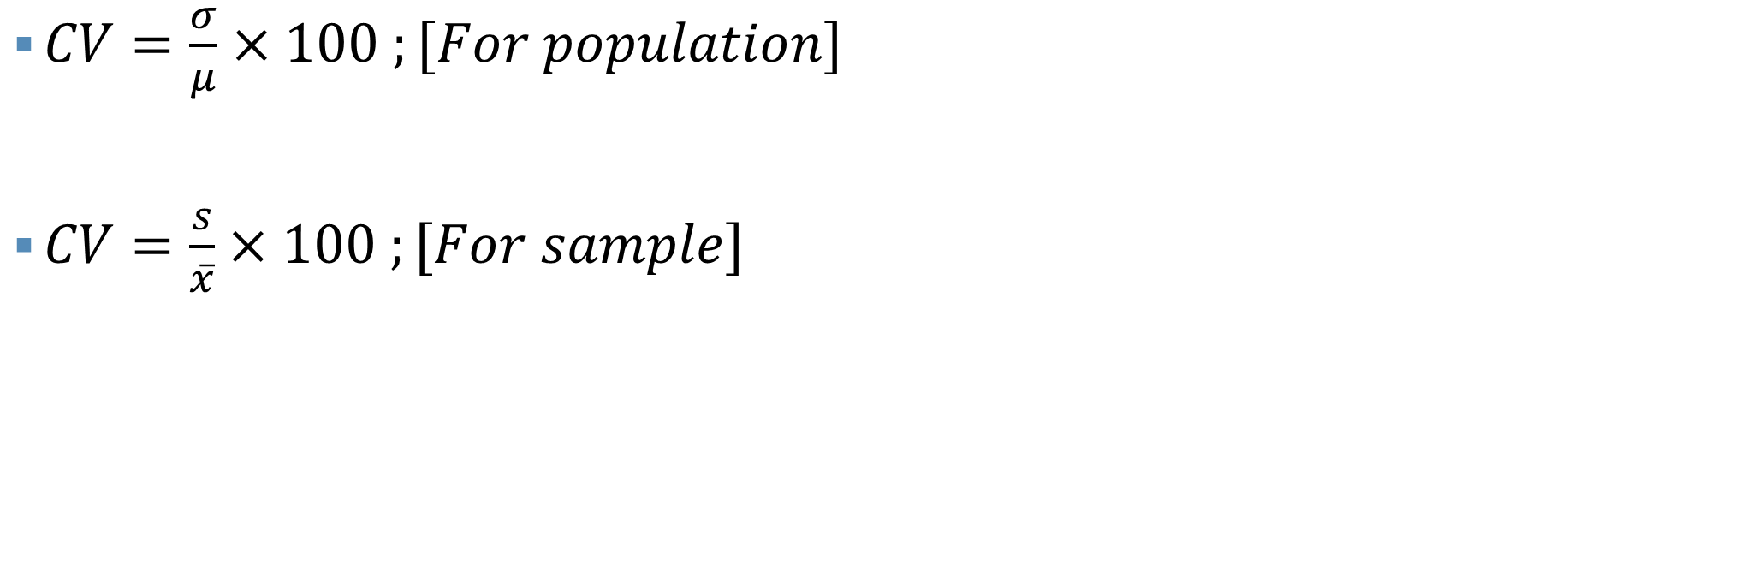
Coefficient of variance (CV)
Higher CV = High variation
Lower CV = Low Variation
$CV=\frac{σ}{μ}×100 ;[For population]$
$CV=\frac{s}{\overline{x}}×100 ;[For sample]$
More consistent
More uniform
More stable
More homogeneous

Slide 52
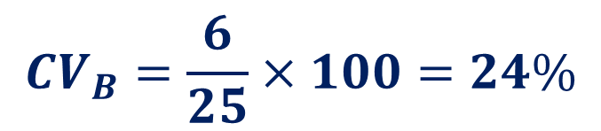
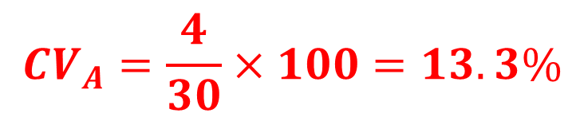
Coefficient of variance (CV)
$$CV_{A}=\frac{4}{30}×100=13.3\%$$
Section A: Mean = 30 and SD = 4
Section B: Mean = 25 and SD = 6
Which section is more consistent in getting final exam mark?
$$CV_{B}=\frac{6}{25}×100=24\%$$
Since, the CV of A is lower than the CV of B.
Thus, section A is more consistent comparatively section B

Slide 53
Thank You

